Slide 1
Intro to Programming
C/C++
Sankalp Gupta
moklaeducation@gmail.com

Slide 2
Learning Goals
Comfort with
Basics of C/C++
Basics of Computer Science
Familiarity with IDE
Visual Studio Community Edition
Thinking logically
i.e. One step at a time
And Visualizing how computer works
Independence of technology

Slide 3
Why C/C++
Foundational understanding
Understand Computer Science
Speed and control
Fastest programming language
Really small programming language
C has 32 keywords
C++ has 92 keywords as of 2023
Makes you digital native

Slide 4
When NOT C/C++?
Slower manual speed of writing code
Don’t care about speed
Don’t care about deep Computer Science
Although this may not be achievable

Slide 5
Bit : Smallest unit of memory
Bits are used for representing everything
Have 2 states : 0 and 1 , like a bulb
On : 1
Off : 0
Nibble : 4 bits
Byte : 8 bits
int (integer ) 4 bytes
char (character ) 1 byte

Slide 6
Hertz : Unit of time and speed in Computers
1 Hertz : once per second
1 unit of work per clock instruction
Modern processors
Measured in Giga hertz
High Core Counts
More instructions

Slide 7
Hello World
Let’s go ,
Program to print “Hello World”
-----
#include <iostream> using namespace std; int main()
{
cout << “Hello World”; return 0;
}

Slide 8
Print a diamond pattern
*
***
*****
***
*

Slide 9
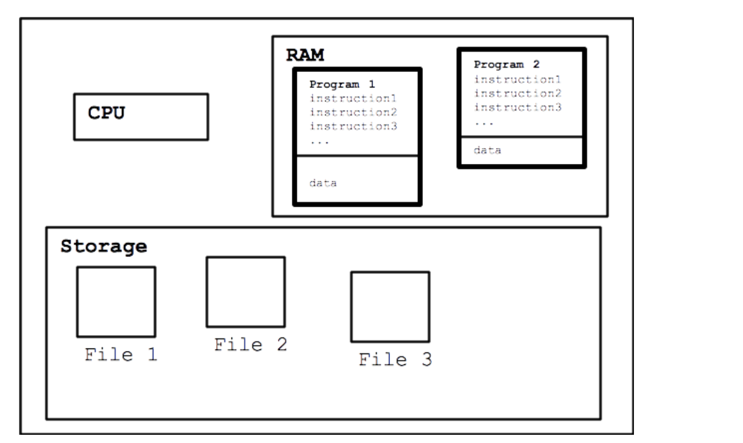
Running the program : model

Slide 10
Data Types(Primitive/built in)
bool
int
short(2), long(4)
signed,unsigned
float
float(4), double(8) , long double(8,10,16)
char(1)
signed,unsigned
wchar_t(2)
void

Slide 11
Variables
Containers for storing data
Value can change during execution (unless you don’t want it to)
Declaration
int birthyear;
float weight;
char courseGrade;

Slide 12
Data Types (Derived)
Arrays
char name[100];
Size 100
Index : 0 - 99
int age[10];
Size 10
Index : 0 - 9
float power[20]
Size 20
Index : 0 - 19

Slide 13
Integer vs floating math
Division
Float :continuos, contains decimal point
Int : discrete , truncates everything after decimal ,
float f = 10;
cout << f/3;
3.33
int i = 10;
cout<< i/3;
3

Slide 14
Type Name | Bytes | Other Names | Range of Values
int | 4 | signed | -2,147,483,648 to 2,147,483,647
unsigned int | 4 | unsigned | 0 to 4,294,967,295
bool | 1 | none | false or true
char | 1 | none | -128 to 127 by default
signed char | 1 | none | -128 to 127
unsigned char | 1 | none | 0 to 255
short | 2 | short int, signed short int | -32,768 to 32,767
unsigned short | 2 | unsigned short int | 0 to 65,535
long | 4 | long int, signed long int | -2,147,483,648 to 2,147,483,647
unsigned long | 4 | unsigned long int | 0 to 4,294,967,295
long long | 8 | None | -9,223,372,036,854,775,808 to 9,223,372,036,854,775,807
unsigned long long | 8 | none | 0 to 18,446,744,073,709,551,615
enum | varies | None
float | 4 | None | 3.4E +/- 38 (seven digits)
double | 8 | None | 1.7E +/- 308 (fifteen digits)
long double | 8 | None | Same as double
wchar_t | 2 |  | 0 to 65,535

Slide 15
User Defined Data Type
Enum
Short for enumeration
Define a set of named, integer constants
enum ESpeed { low, medium, high }; ESpeed fanSpeed; fanSpeed = low;

Slide 16
Code : Greeting with name/age
Given user
Store name in char array ( char name[100] )
Store year of birth in int( int birthyear)
Calculate age
age = currentYear – birthyear;
Print Name, age.
cout <<“Hello “
<< name <<“ I know your age is :“ <<age;

Slide 17
Advanced : Count digits in a number
Define a number
Return the number of digits, (assume positive)
129 → 3
34 → 2
0 → 1
Hints
You need to know loops
while
You need to know integer maths
division

Slide 18
Input , Output and Processing for Humans
Speech
Process →Speak →Listen
Book
Read →Process → Memorize
Conversation
Listen → Speak →Listen →Speak ….

Slide 19
I/O and processing for Computers
Video games
Input (controllers) →Process →Output (Screen)
Movies
Input (network) →Process → Output (visuals, audio)
Console
Input(char, int, float) → Process →Output (char(s), int, float)

Slide 20
Standard Input
cin
Read data from keyboard
Store it in variables
Extraction operator
>>
Can use multiple data types ( char, int, float , …)
Example
int age;
cin >> age;

Slide 21
Standard Output
cout
Write data to console/Screen
Reads from memory
Insertion operator
<<
Can use multiple data types(variables, literals, constants)
Example
int age = 172;
cout << age;

Slide 22
Operators >>,<<
Extraction and Insertion operators
Can be cascaded
cin >>age >> name;
cout<<age << name;
<< works with stream modifiers
“\n” : newline
cout <<“\n”; //moves the cursor to new line
Or cout <<endl; //Same visual effect as “\n” but is different
(there are other stream modifiers too)

Slide 23
Lab
Using Cin ( Hint: define a variable first)
Input a character (char)
Input an integer(int)
Input a decimal( float)
Using cout
Output a character
Output an integer
Output a decimal.
Use endl and “\n”
Cascade the operators

Slide 24
string data type
We know
Int , float , char
string
Derived data type,
Useful for names, description etc.
Header
#include<string>
Usage
string name;
cin >> name;
cout <<name;

Slide 25
Assignment : Mad libs story
#include <iostream> // Required for input/output operations (cout, cin) #include <string> // Required for using string data type int main() { std::string adjective1, noun1, verb1, adjective2, noun2; // Prompt the user for input and store it in the variables std::cout << "Enter an adjective: "; std::cin >> adjective1; std::cout << "Enter a noun: "; std::cin >> noun1; std::cout << "Enter a verb: "; std::cin >> verb1; std::cout << "Enter another adjective: "; std::cin >> adjective2; std::cout << "Enter another noun: "; std::cin >> noun2; // Construct and print the Mad Libs story std::cout << "\n--- Your Mad Libs Story ---\n"; std::cout << "Once upon a time, there was a " << adjective1 << " " << noun1 << ". It loved to " << verb1 << " all day long.\n" << "One day, it met a " << adjective2 << " " << noun2 << ", and they lived happily ever after.\n"; return 0; // Indicate successful program execution }

Slide 26
Boss Assignment
Input student details
Student Name
Subject name
Marks ( out of 100)
Process
Find grade using this table
90 <marks →A
75 <= marks < 90 →B
60 <= marks <=74 →C
marks <60 →D
Output
Grade for the student
Challenge
Enter multiple students, print how many students had A, B , C and D grades each.
Hint
Need to know conditional (if-else)
May need to know loop (while)

Slide 27
Conditionals
Are you going to store?
Yes
If they have chocolate, get two , if not then get icecream
Ok.
Code
if( haveChocolate) { //Buy 2 chocolate } else { //Buy icecream }

